Slide 1
¡Bienvenidos a Español!

Slide 2
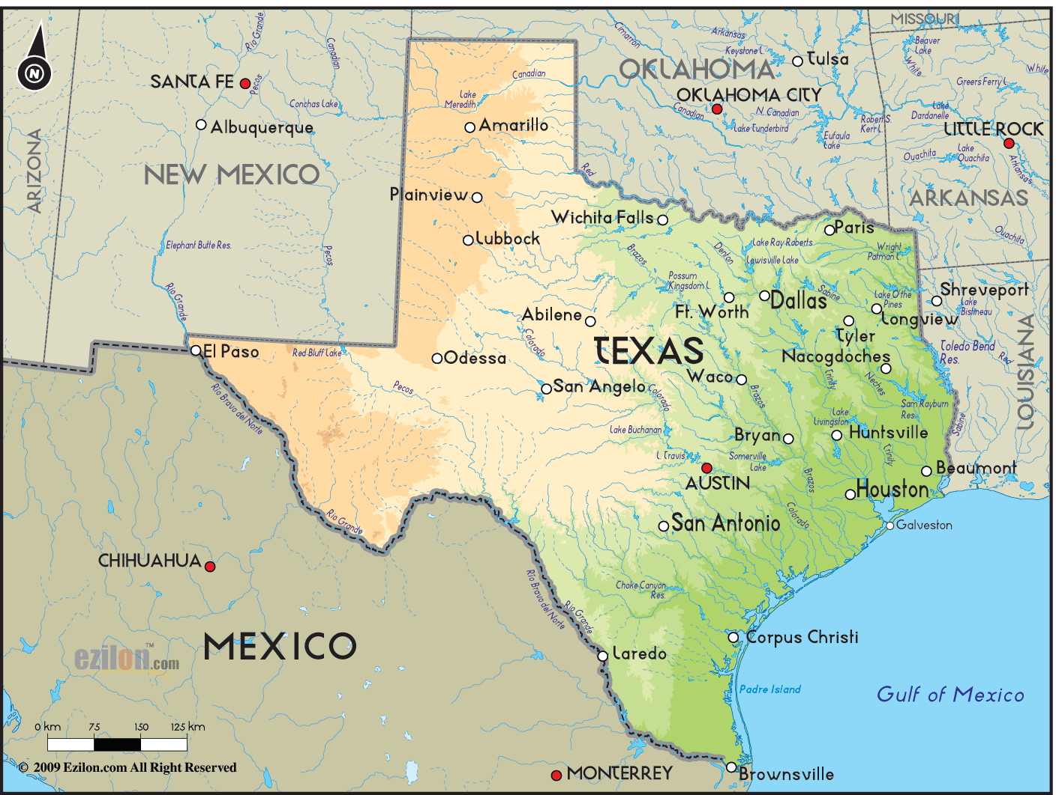
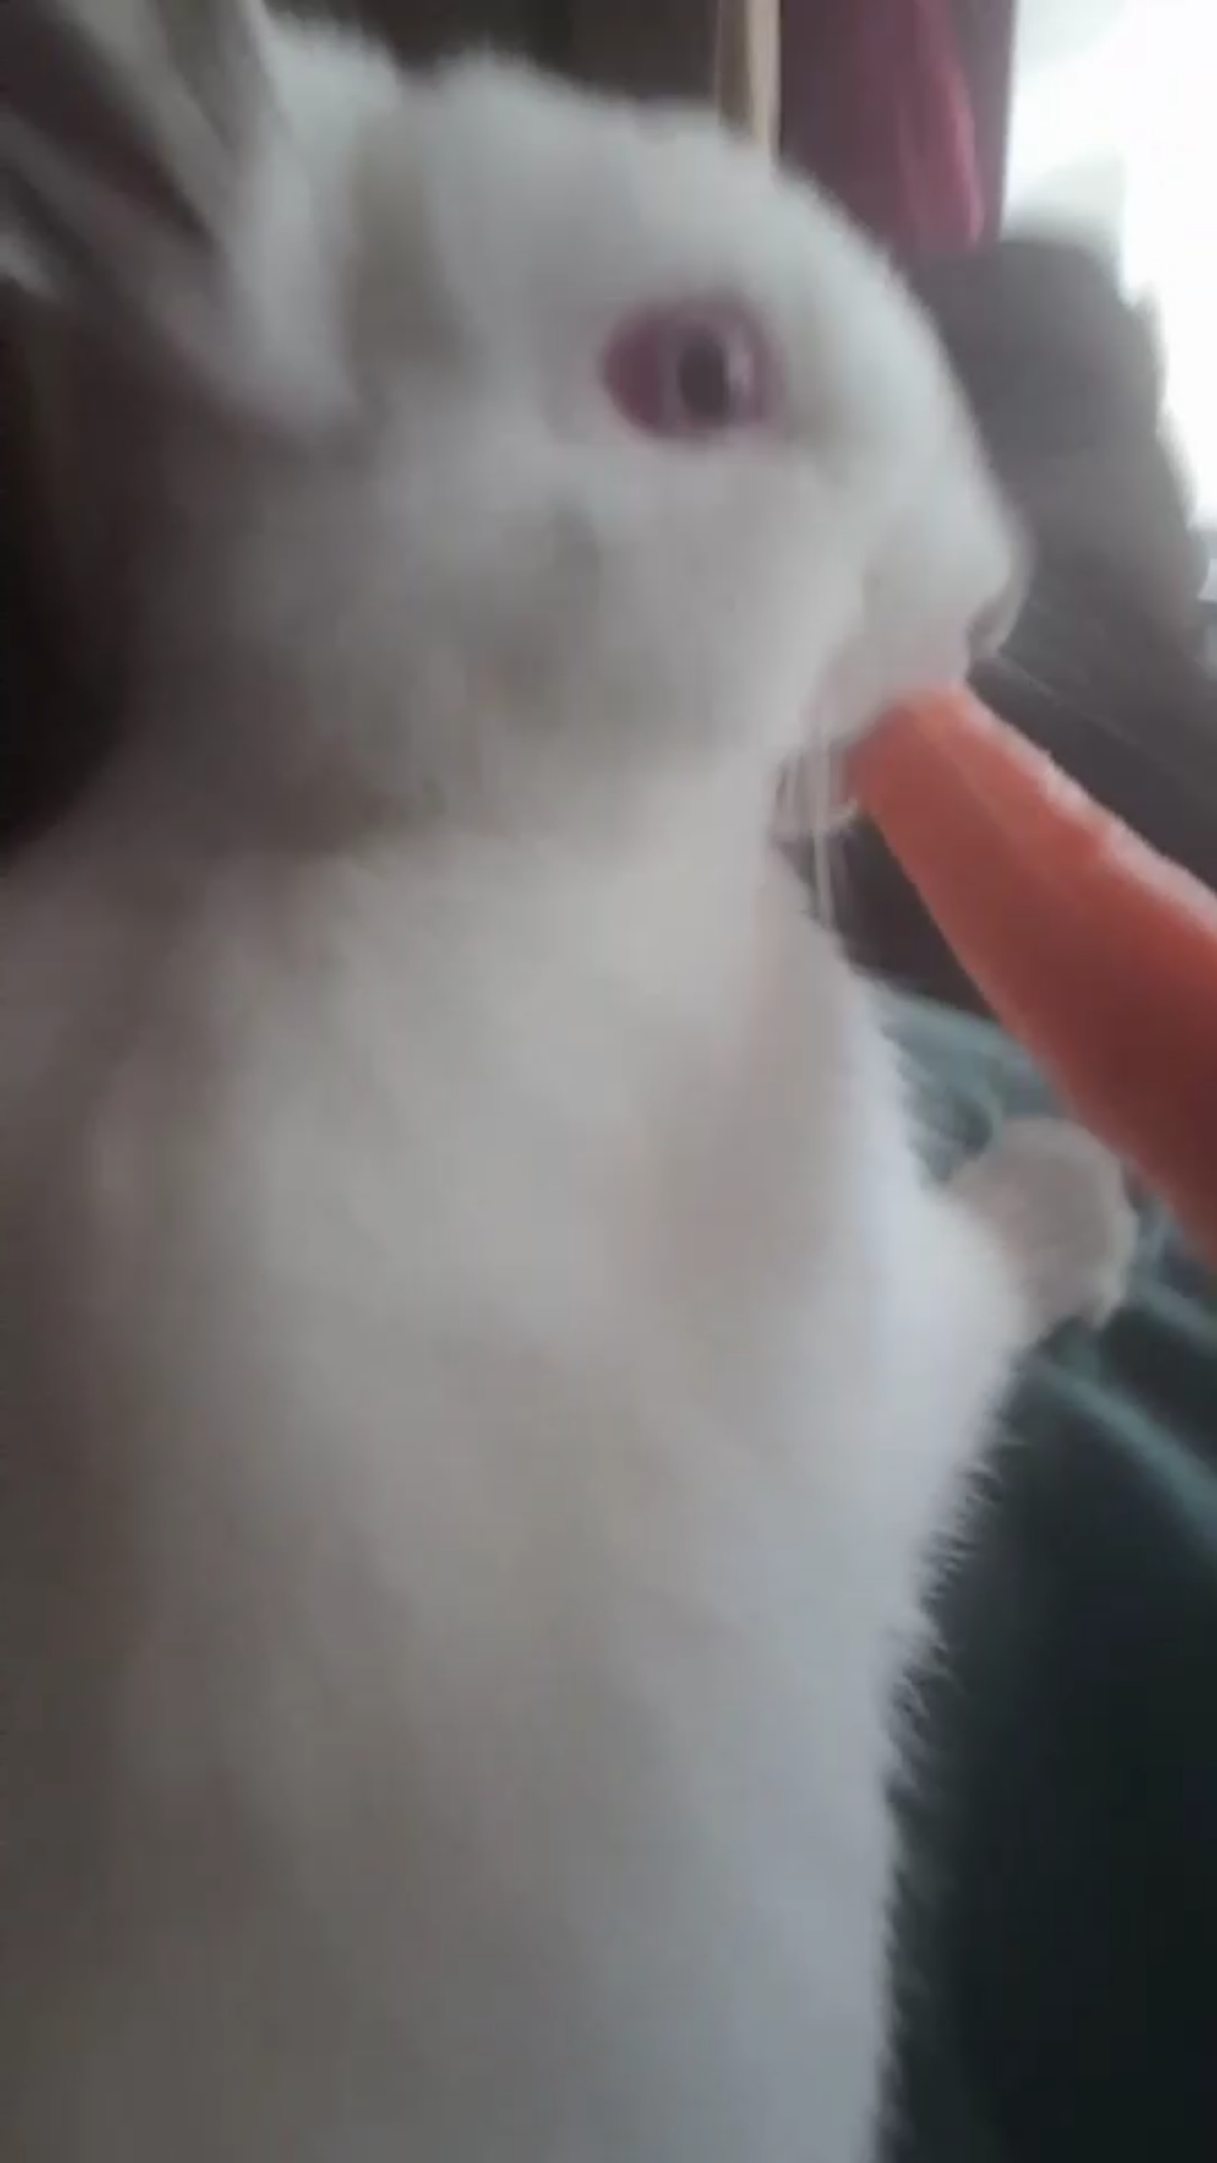
Señorita Jurado
I am from Eagle Pass, Tx. It is my second year teaching at ACA and my 4th year teaching Spanish. I have a pet rabbit and her name is Pantunflas.

Slide 3
Señorita Jurado: Educación
Texas A&M- Kingsville
Bachelors of Arts in Education
Majors: Theater and Spanish

Slide 4
Srta. Jurado: Why Spanish is important to me.
Where I am from.
The culture.
How important it is in the world. (fun facts)

Slide 5
¡Excelente! ¡Me gusta! ¡Me encanta!

Slide 6
¿Por qué estamos aquí?

Slide 7
Expectativas de la clase:
Debes estar en tu asiento o area asignada, y listo/lista para trabajar cuando empieze la clase.
Tener hojas de papel, lápices, libros y todos los útiles necesarios.
Manten manos, pies, libros y objectos contigo.
No digas cosas profanas, gestos groceros, burlas o instultos.
Segue las instrucciones de todo el personal de Arlington Classics Academy.

Slide 8
¡Excelente! ¡Me gusta! ¡Me encanta!

Slide 9
Class expectations
Be in your assigned seat or area, ready to work when class begins.
Have a paper, pencils, books, and all needed supplies every day.
Keep hands, feet, books and objects to yourself.
No profanity, rude gestures, bullying, teasing or put downs
Follow directions of all school personnel.

Slide 10
Distractores
If an object distracts you from learning: a book, rubrics cube, crayon bag, I will pick it up from you and take it to my office. I DO NOT WANT TO KEEP IT. You can get it back by writing a letter to me, stating your regrets and agreeing to not let that object distract you from learning. Sign it and get it signed by a parent. When I get the letter you get the object that was causing the distraction. Try to do it ASAP.

Slide 11
Cell phones: in accordance with student handbook.
PHONE CALLS/CELL PHONES Students are not allowed to receive phone calls at school. If necessary, parents may contact the office to leave a message for their child. This should be reserved for emergency situations only. During school hours cell phone use is not permitted except when specified by the teacher or course description for educational purposes only. All cell phones must be turned off and stored in a locker, cubby and/or backpack. Inappropriate cell/smart phone use (including use for reasons other than education when designated by the teacher or course) will result in confiscation of the device and a $15 fine will be assessed for each event after the first event. ACA is not responsible for lost or stolen cell phones.

Slide 12
¡Excelente! ¡Me gusta! ¡Me encanta!

Slide 13
Mi meta:

Slide 14
Refocus area
The purpose of the refocus area is to give you a chance to get away to think and to decide to change your behavior for the better. It is an area to help you cool off and… refocus on what is important: your education, your surroundings, you.

Slide 15
Buddy room
For refusing to go to the Refocus Area.
For being disruptive in the Refocus Area.

Slide 16
¡Excelente! ¡Me gusta! ¡Me encanta!

Slide 17
Rutina de la clase
You will wait for me outside the classroom. Lined up in a neat area unless there is bad weather.
If there are any special instructions I will say it before I let you in, pay attention.
I will greet you at the entrance. Hand shake, eye contact, and verbal greeting.
Come in, look at the board and follow directions projected.
Write down date and objective.

Slide 18
Tarea
-10 points for turning in homework after it is due.
-30 for turning it in 2 days after it was due.
I do not want it after that.

Slide 19
Materials
Five-subject spiral notebook
Fecha y objetivo
Trabajos de calentamiento
Notas
Gráficas
2 packs of index cards (3¨X 5¨)
Spanish-English dictionary

Slide 20
Grading
Homework 10%
Classwork 40%
Tests 40%
9-wks Exam 10%

Slide 21
Todo lo técnico
Website: srtajurado.weebly.com
Email: vjurado@acaedu.net
Extension: 1304
Office: 308
Tutoring: Mon-Wed. from 7:45am-8:20am
Conference Periods:
A Day: 1st period.
B Day: 6th Period.

Slide 22
Mi declaración de dedicación:
J
U
R
A
D
O
oyful learning
nderstanding and supportive
eliable knowledge
werness of wellbeing
oes not let you give up
ptimistic

Slide 23
¡Excelente! ¡Me gusta! ¡Me encanta!

Slide 24
Asistentes:
Helpers will be rotated periodically
Pass out papers > put name of person that is absent > tray. (2)
Pick up papers and order them alphabetically for turn in. (2)> (1)
La Fecha y objetivo del día. (1)
Diccionarios (2)

Slide 25
Ausente:
If you are absent, find your missing work on the tray. If you know you are going to be absent LET ME KNOW at least two days before you’re gone.

Slide 26
¡Excelente! ¡Me gusta! ¡Me encanta!

Slide 27
Poder de las tarjetas ….Folder
Tu color, comida, y materia favorita
Mi color favorite es el morado. Mi comida fa….
Tu pasatiempo favorito
Lugares, países, ciudades o estados a los que hayas visitado
¿Tienes computador, internet o impresor?
¿Cuánto español crees saber?
Escribe algo unico sobre ti

Slide 28
Speedy Gonzalez
If you happen to be of those who has finished their work and is ready for the next great thing: Los valores worksheets are located under the tray. Work on the ones you have not already. You can use these at the end of the 9-wks for additional credit. Keep them neatly in a separate folder.

Slide 29
¡Excelente! ¡Me gusta! ¡Me encanta!

Slide 30
Hablar español fuera de clase
Every 9-weeks period you will be challenged to speak Spanish outside of class. You will be given a card stock paper in which you will collect initials for speaking Spanish with other teachers. The student that collects the most initials wins a prize from another Spanish-speaking country!!
Not obligatory
A minimum of 25 initials for the first 9-wks period, 30 for second 9-wks, 35 for third 9-wks, 40 for last 9-wks. (Record is 240 initials)
Personnel that can help:
Sra. Jenson
Sr. Flood
Sra. Murphree
Pen/ink only
One side of paper per 9-wks period
From me> one signature in class, one out of class per day.
One winner per class.
Sra. Westmoreland
Sr. Destefani
Srta. Delgado

Slide 31
Anuncios
Your advisory periods are your last periods of the day, 4th and 8th.
Lunch might be late for some of you so a HEALTHY snack is okay for you to have if you are hungry. Water ONLY.

