Slide 1
Perú, España, and Puerto Rico only.
Flag must be on a whole, white, copy paper
No markers just crayons or color pencils
Write infromation about date of independance, location, and flag meaning detrás de la bandera.

Slide 4
On back of flag
Guinea Ecuatorial:
12 de octubre del 1968
Este de África
This coat of arms shows a grey shield, which contains a tree. This tree is a silk cotton tree, or so-called "God tree". This is where the first treaty was signed between Portugal and the local ruler. Over the shield, there are six six-pointed stars. They stand for the mainland and the five main islands.

Slide 5
On back of flag
Panamá:
3 de noviembre del 1903
Cenroamérica
The flag of Panama was made by María de la Ossa de Amador and was officially adopted by the "ley 48 de 1925".^{[1]} The Panamanian flag day is celebrated on November 4, one day after Panamanian separation from Colombia.

Slide 6
.gv
On back of flag
Republica Dominicana:
1º de diciembre del 1801
Carribean Sea
The flag of the Dominican Republic represents the Dominican Republic and, together with the coat of arms and the national anthem, has the status of national symbol. The blue on the flag stands for liberty, the white for salvation, the red for the blood of heroes. The civil ensign follows the same design, but without the charge in the center. The flag was designed by Juan Pablo Duarte.

Slide 8
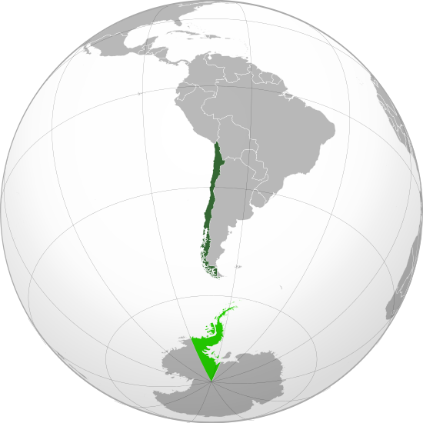
Chile
18 de septiembre de 1810
Chile is today one of South America's most stable and prosperous nations. It leads Latin American nations in rankings of human development, competitiveness, income per capita, globalization, state of peace, economic freedom, and low perception of corruption.

Slide 13
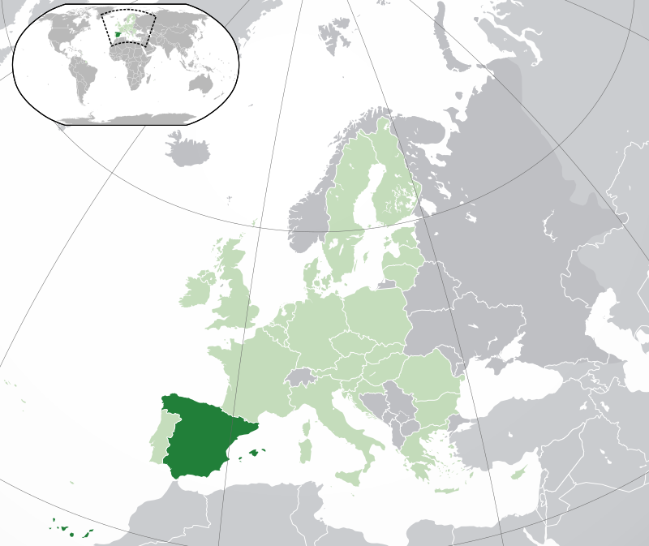
España
Madrid
Día nacional: El 12 de octubre del 1492

Slide 14
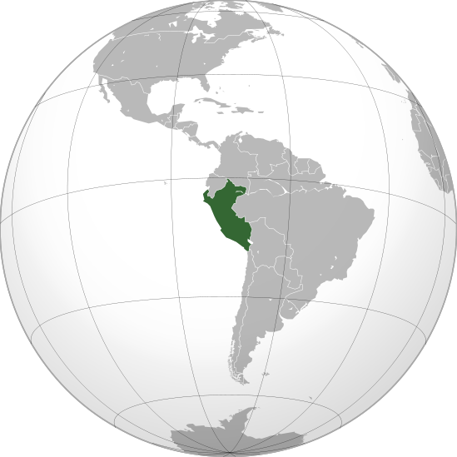
Perú
Lima
El doce de julio del 1898

Slide 15
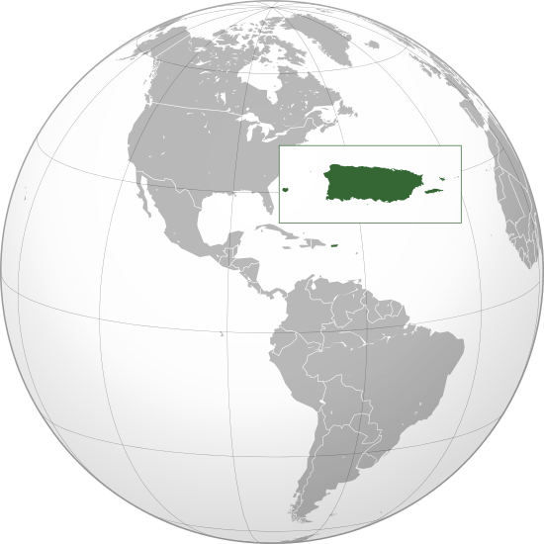
Puerto Rico
San Juan
El cuatro de julio de 1776

