Slide 1
Uruguay
25 de Agosto

Slide 2
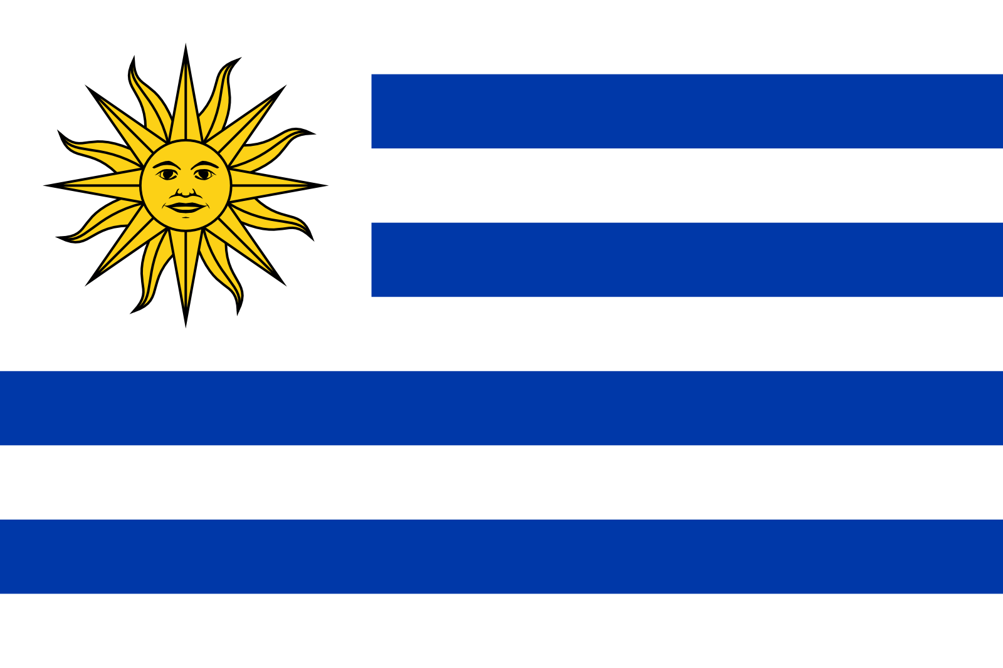

Slide 3
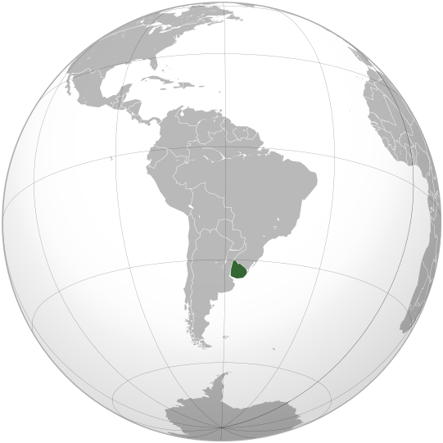
¿Dónde está Uruguay?

Slide 4
Meaning of flag:
The horizontal stripes on the flag represent the nine original departments of Uruguay. The first flag designed in 1828 had 9 light blue stripes; this number was reduced to 4 in 1830 before the proclamation of the country's first Constitution. The Sun of May represents a new nation in the world.

Slide 5
How does Uruguay celebrate its independence?
One of Uruguay’s most revered public holidays, the anniversary of the country’s independence from the Spanish and Portuguese colonial power achieved in 1825 falls on August 25. The festivities start during the afternoon and in certain places such as Montevideo, rage on until the early hours of the morning.

Slide 6
Continued…
Independence Day signifies that the country is now free and it is no more under the rule of anyone. A feel of freedom is aroused within each and every citizen. It is declared as a national holiday and all the people come together to celebrate this day in a grand way. As this day comes after a lot of struggle and hardship. So undoubted there will be lot of excitement and joy among the people. This day remind the citizens of the Uruguay that it was due to efforts of many that it is free and so they should respect the day.

Slide 7
Continued…
On this day school, colleges and the working of a country are suspended. The national heroes, who worked hard to make the country independent, are honored, national flag is hoisted, and parade takes place and many more. There are some communities, which makes this day and aims at rising of funds for institutions such as hospitals and rural schools in Australia and Uruguay, many events are organized. It is a night of concerts and fireworks. Thus, this way to help out the needy ones. Every year, people try to make this day very attractive and memorable.

Slide 8
Homework
Find more information about Uruguay
1. Type of government and currency
2. Famous dishes and famous people from Uruguay
3. Population and states (How many states, and their capitals)
4. Uruguay´s geography and climate
5. Crime in Uruguay

Slide 9
Sources
http://aglobalworld.com/holidays-around-the-world/uruguay-independence-day/
Wikipedia
http://www.iexplore.com/travel-guides/central-and-south-america/uruguay/festivals-and-events

